Slide 1

IDFC DILAPIDATED PROPERTIES AND VACANT LAND AVAILABLE FOR DEVELOPMENT

Slide 2
COMMERCIAL DILAPIDATED PROPERTIES AND VACANT LAND

Slide 3
  KWAMASHU AMBEV - OVERVIEW
E1137 Kwamashu Ambev is a partly dilapidated commercial property located at Kwamashu township, K section next to the Kwamashu Police station, within eThekweni Municipality, KwaZulu Natal.
UNIT C – Offices - dilapidated
UNIT D - Ablution and stores
UNIT G – Existing Dog House - Used by Previous security company - dilapidated
UNIT H – Existing Dog House - Used by Previous security company - dilapidated
UNIT I – Existing Carport - dilapidated
UNIT J - Existing Carport – dilapidated
UNIT K - Existing Guardhouse - dilapidated
Service Infrastructure | Confirmed details
Sewer Network | The site is located within a municipal sewer line, further investigations to check if the system is functional is required
Electrical infrastructure | Vandalized and non-functional.
Water lines. | The site is located within a municipal water line which is functional.
Storm-water Control | There is an existing storm-water drains, underground pipe network and V drains. The system needs further investigations to check any blockages.
Property Status | Confirmed details
Extent of land. | 9167 m2
Land and building owner | Ithala Development Finance Corporation
Access to property. | Two access gates are available 1. Next to block K (currently in use) 2. Currently not in use
Boundary | Palisade concrete fence - satisfactory condition

Slide 4
  KWAMASHU AMBEV – CONDITIONAL ASSESSEMENT OF DILAPIDATED SECTIONS
Unit C & D (Offices, Stores and Ablutions)
Architectural, Civil & Structural Engineering Observations
The facility is vandalised both structurally & architecturally, leaving all electrical, mechanical, electronics & sanitary fittings deemed unfit for usage.
The building shell appear to be structurally sound based on the Engineering and Architectural Visual Assessment.
The main items to be salvaged are the Internal, External walls & Surface Beds.
The existing asbestos roof coverings to be replaced
The available parking spaces are in line with the eThekwini LUMS & ETA Guidelines.
Landscape - the yard is paved with concrete and now has overgrown vegetation and trees due to neglect and non-maintenance.
Existing parking to be replaced
An integral part of the repairs to the facility is preventative measures & security upgrades

Slide 5
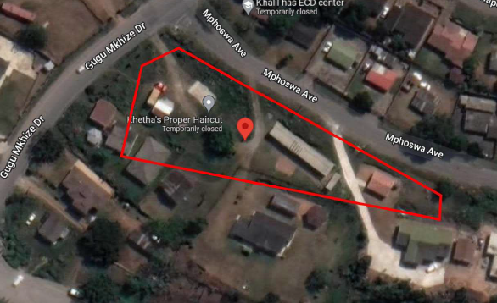
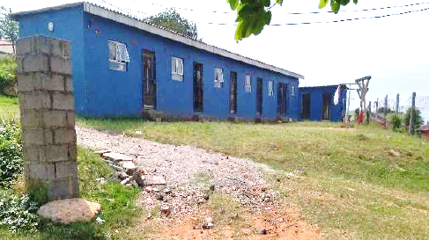
  A3202 KWAMAKUTHA - OVERVIEW
A3202 Kwamakutha is an invaded commercial land located at Kwamakutha township, within the eThekwini Municipality, Durban, KwaZulu-Natal.
Property is located at Kwamakutha township about 5 km away from Amanzimtoti.
Erf A3202 is invaded by about 4 homesteads including an RDP house built by the local Municipality. A bigger portion of the land is invaded by a car wash consisting of 2 accompanying structures which are a block of residential rental units and an RDP house.
Opportunity for small supermarket to be developed.
Property Status | Confirmed details
Extent of land. | 2309m²
Land owner | IDFC
Lease status | None - invaded
Current Monthly Income | Nil
Access to property. | Open Access
Boundary | None

Slide 6
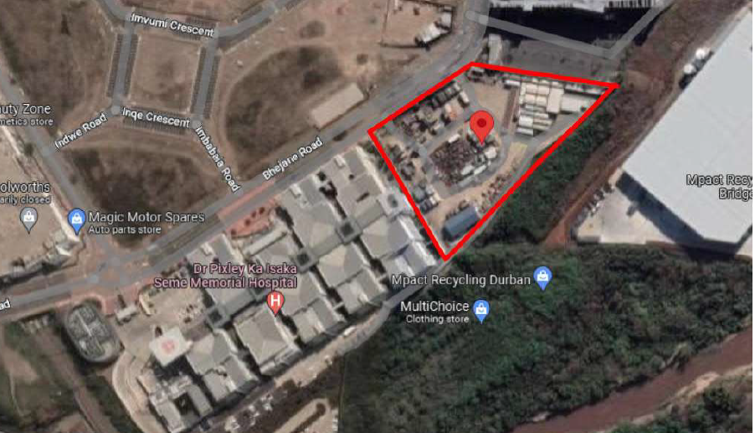
  KWAMASHU ERF 2 BRIDGE CITY- OVERVIEW
Erf 2 Bridge city is a vacant commercial land located at Bridge city town centre at Kwamashu, within the eThekwiniBMunicipality, Durban, KwaZulu-Natal.
Bridge city is a town centre being developed through a joint venture between Tongaat Hulett developments and eThekwini Municipality. The land is located at an area with high potential to generate income, since the site is at the centre of the Bridge city town centre.
Property Status | Confirmed details
Extent of land. | 13 629 m2
Land owner | Ithala Development Finance Corporation.
Building owner | No permanent building in place
Municipal rates cost | R152 328 (account is up to date)
Access to property | Security controlled mesh wire gates
Boundary | Mesh wire fence in a good condition
Service Infrastructure | Confirmed details
Sewer Network | Serviced - Sewer mains available for connection on permanent structure
Electrical infrastructure | Serviced. Electricity connected for temporary use by tenant.
Water lines | Serviced. Water connected for temporary use by tenant
Storm-water Control | Serviced

Slide 7
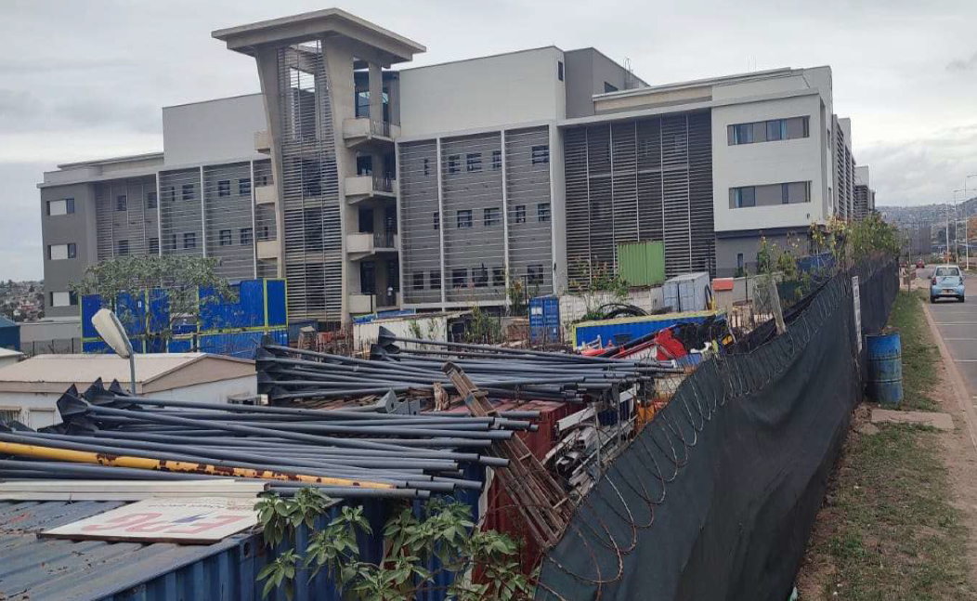
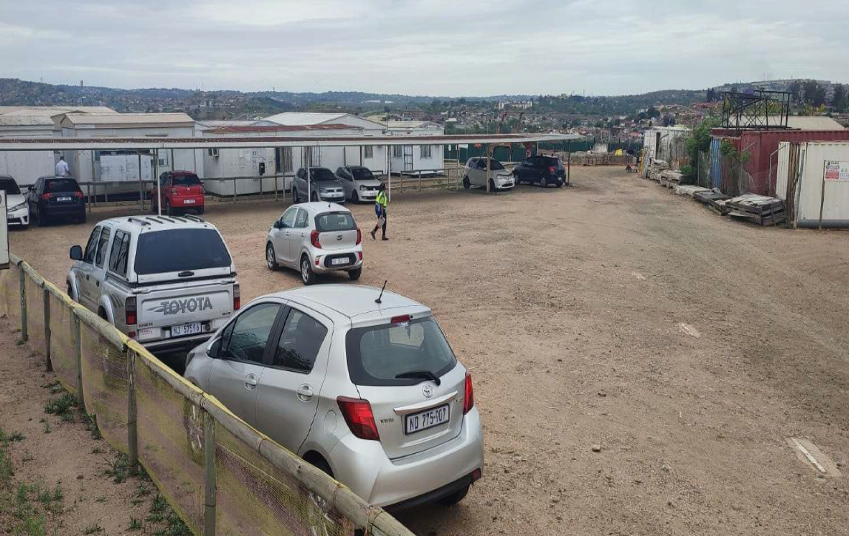
  KWAMASHU ERF 2 BRIDGE CITY- SITE VISIT FINDINGS
Property is a vacant commercial land, located at Bridge City town centre which is about 17 kilometres from the Durban city centre, connecting the communities of Phoenix with Inanda, Ntuzuma and KwaMashu.

Slide 8
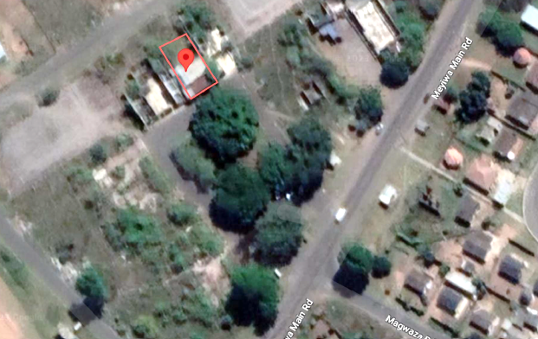
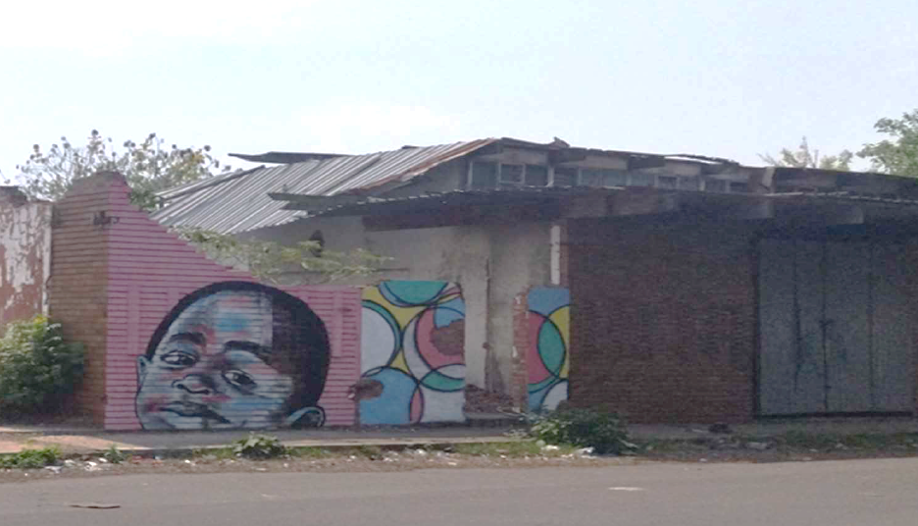
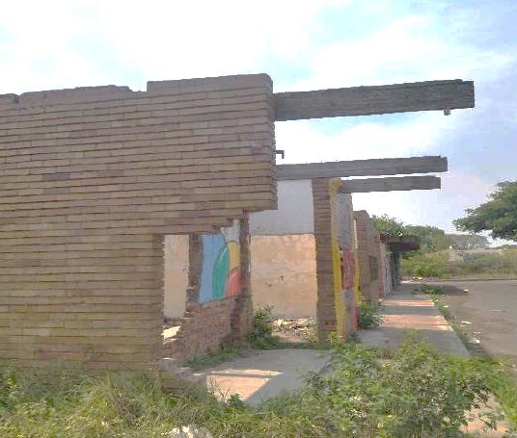
  MPUMALANGA A1852 - OVERVIEW
A1852 Mpumalanga is a dilapidated commercial property located at B section of Mpumalanga widely known as Hammersdale township, situated about 50 km West of Durban, within eThekwini Municipality
A1852 is a unit building which is part of a multiple unit building with a total of five (5) units. It is situated at the centre of two (2) unit buildings thus sharing walls on either side.
The property is currently laying idle without any business activity on it, thus giving opportunity for loiters to use it at their will. It has been vandalised and is currently in a dilapidated state such that, it is unsafe to accommodate any form of business.
Property Status | Confirmed details
Extent of land. | 329 m2
Land owner | Bantu Investment Corporation LTD (IDFC)
Building owner | Bantu Investment Corporation LTD
Lease status | None - VACANT
Current Monthly Income | Nil
Municipal rates cost | R 372
Access to property. | Vandalised back door, open access.
Boundary | None

Slide 9
  B1886 MPUMALANGA - OVERVIEW
B1886 Mpumalanga is a vacant commercial land located at Mpumalanga B section within the eThekwini
Municipality, Durban, KwaZulu-Natal.
Property is vacant commercial land, located at Mpumalanga B section within eThekwini Municipality. As the property is currently laying idle, activities such as illegal waste dumping and small scale farming are currently being undertaken on the property.
Property Status | Confirmed details
Extent of land. | 2117 m²
Land owner | IDFC
Lease status | None – vacant land
Access to property. | Open access
Boundary | No Boundary fence

Slide 10
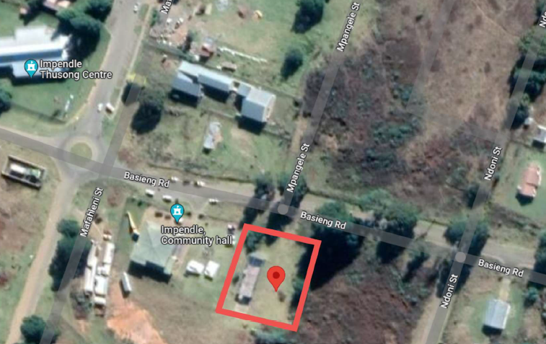
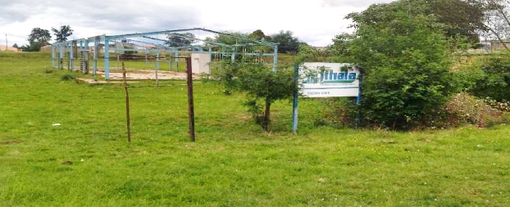
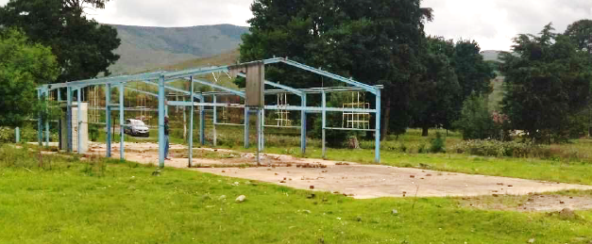
  ERF 55 IMPENDLE - OVERVIEW
Erf 55 Impendle is a dilapidated commercial property located at Impendle, within Impendle Municipality. ADJACENT VACANT LAND BELONGS TO MUNCIPALITY.
Property was previously used as a mechanic workshop by local tradesman. It is currently in a dilapidated state due to vandalism and neglect. Only the Steel frames of the building remains and with all cladding materials missing, possibly due to vandalism and deterioration of building materials overtime.
The structure is in an unacceptable condition to function as it is completely dilapidated.
Recommendations:
  i. Auto repair centre.
  ii. Tyre fitment.
  iii. Auto parts store.
Property Status | Confirmed details
Extent of land. | 2 484 m2

Slide 11
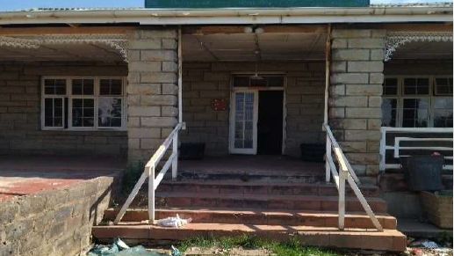
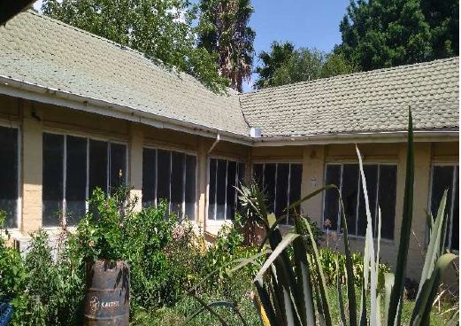
  360 BERGVILLE - OVERVIEW
360 Bergville is a dilapidated commercial property located at Bergville, within Okhahlamba Municipality, KwaZulu Natal.
The structure is in a good condition with reference to the structural integrity however minor repairs and renovations may be required to make it adequately safe and functional.
There is a dilapidated sub-standard outbuilding on the premises which was built by IDFC tenants. Currently the outbuilding is in a dilapidated state, with only the walls and floor slab remaining, the roof, doors, windows and other cladding material are missing from the building. The building was not approved by the Local Municipality thus it is an illegal building which needs to be demolished.
Property Status | Confirmed details
Extent of land. | 4876 m2
Land and building owner | Ithala Development Finance Corporation
Lease status | Not leased
Current Monthly Income | Nil
Municipal rates cost | Monthly R 2 144.33
Access to property. | Open Access – IDFC appointed security on site
Boundary | Security Wall – Good condition

Slide 12
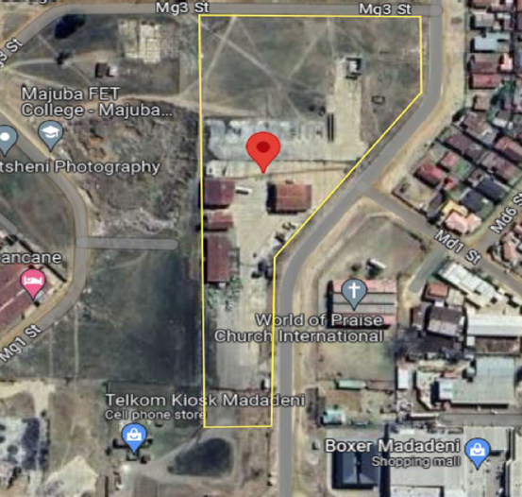
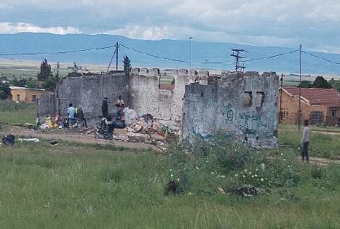
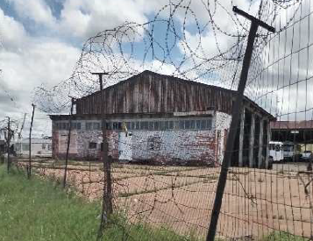
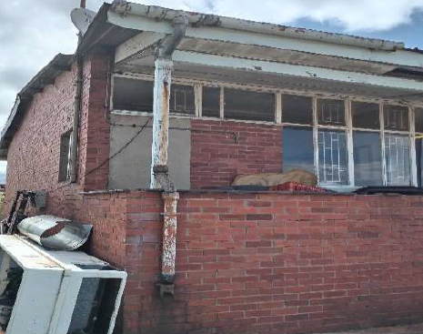
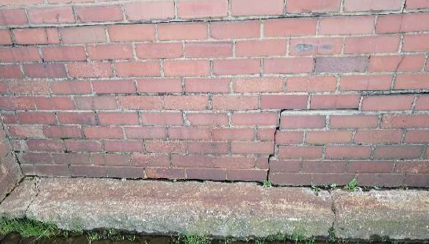
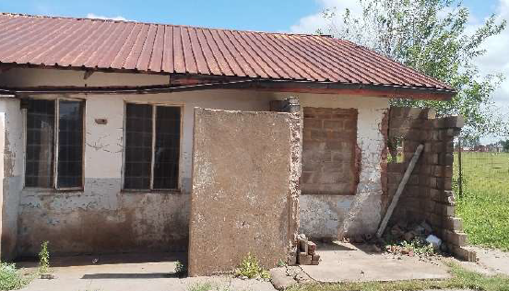
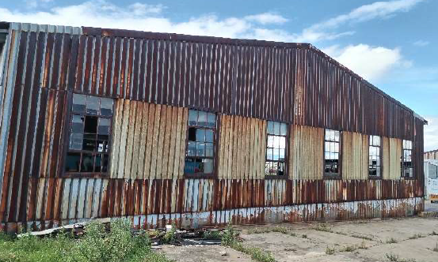
  G9315 MADADENI - OVERVIEW
G9315 Madadeni is an invaded commercial property located at Madadeni G, within Newcastle Local Municipality, KwaZulu Natal
The property is primarily a Bus depot with facilities such as parking accommodation, servicing and maintenance facilities for vehicles, administrative function and facilities for staff.
It is currently in a dilapidated state with very poor structural integrity and functionality however, it is being used by occupants who have invaded the properties.
Property Status | Confirmed details
Extent of land. | 2.5144 H
Service Infrastructure | Confirmed details
Sewer Network | Satisfactory - property is within a municipal sewer line; further functionality checks may be required.
Electrical infrastructure | Unacceptable – facilities functional however they are dilapidated, vandalised and need replacement.
Water lines. | Satisfactory – property located within a functional Municipal water line. Repairs and renovations may be required for the existing property reticulation.
Storm-water Control | Unacceptable - existing storm-water control is dilapidated and insufficient; redesign and construction required.
Dilapidated outbuildings used by loiters
Bus service facility/ garage #02 and dilapidated boundary fence
Wall with cracks and water seepage
Driving School
Dilapidated vehicle service facility

Slide 13
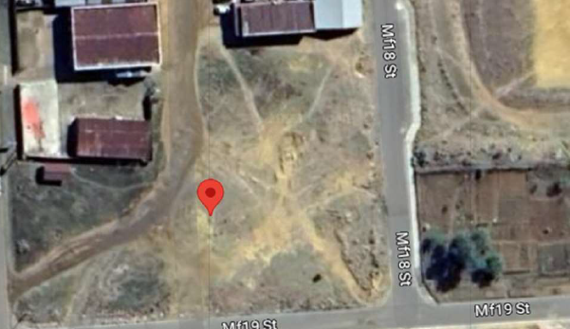
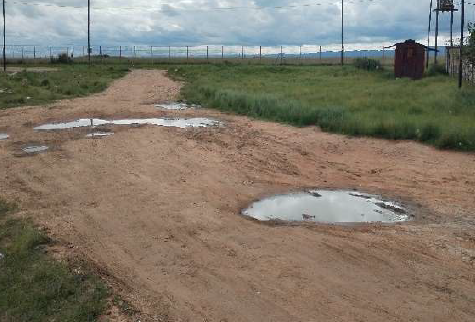
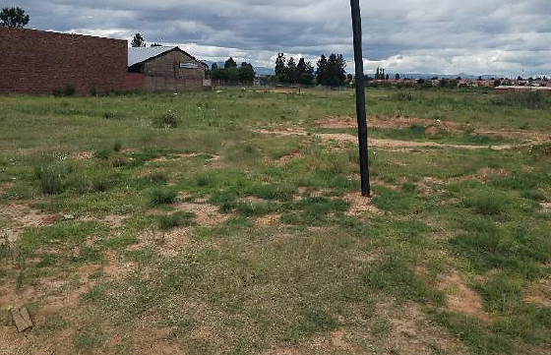
  F501 MADADENI - OVERVIEW
F501 Madadeni is vacant commercial land located at Madadeni F, within Newcastle Local Municipality, KwaZulu Natal.
The property is located within a commercial zone of Madadeni. It is currently vacant and idle without any signs of invasion and/ or use. However, there minor excavations of land.
Businesses operating within area: Eyethu Motor Spares; TS Driveline workshop; Mphephethe trading – Hardware and builder’s supply; Shandu’s Funerals and Sibonelo Meat Market.
Property Status | Confirmed details
Extent of land. | 3746 m²
Land owner | Bantu Investment Corporation (IDFC)
Lease status | None – vacant land
Current Monthly Income | Nil
Municipal rates cost | Property rates unavailable
Access to property. | Open access
Boundary | No Boundary fence

Slide 14
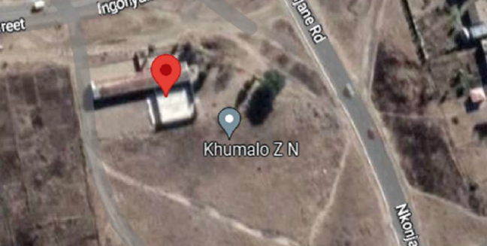
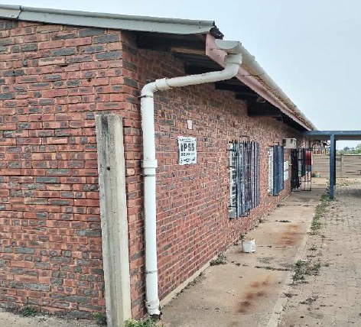
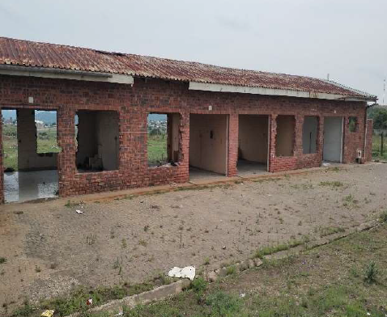
  D2271 EZAKHENI - OVERVIEW
D2271 Ezakheni is a dilapidated commercial property located at Ezakheni D, within Alfred Duma Municipality, KwaZulu Natal.
The property is in a dilapidated state with signs of vandalism to most of the property facilities however, there are no signs of invasion.
The structure is in a satisfactory condition making which requires repairs and renovations to make it safe and functional.
Property Status | Confirmed details
Extent of land. | 2446m2
Land owner | IDFC
Lease status | Vacant
Current Monthly Income | Nil
Municipal rates cost | R1964.91 (Monthly rates); R244.69 (monthly refuse)
Access to property. | Open
Boundary | None

Slide 15
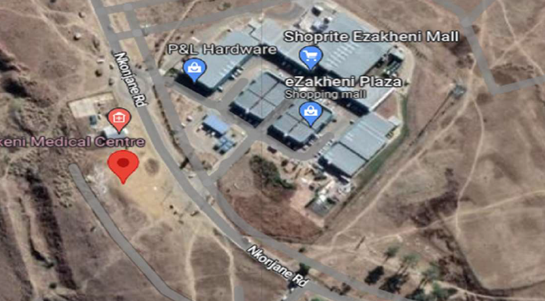
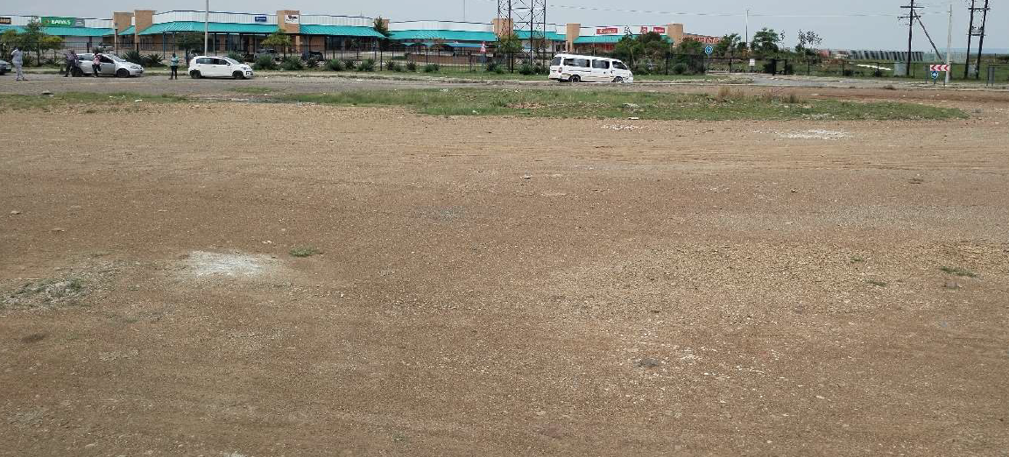
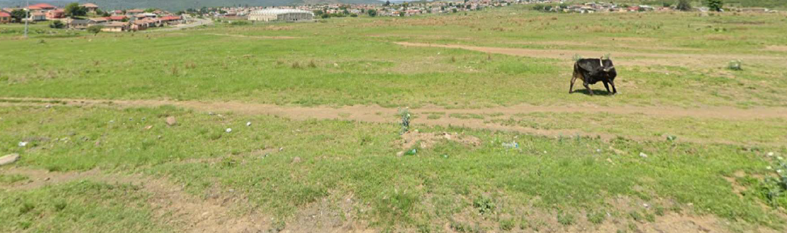
  D5, D6, D8, D9 EZAKHENI - OVERVIEW
The property is vacant commercial land located at Ezakheni D, within Alfred Duma Municipality.
All properties (D5, D6, D7, D8, D9, D10 ) are situated next to each
Property is vacant land located directly opposite a shopping mall, Ezakheni Plaza which has multiple shops including supermarkets and retail shops.
There are no signs of invasion on the land as well as other IDFC owned sites next to the property.
Property Status | Confirmed details
Extent of land. | D5 = 1618m^{2;} D6 = 1 607m^{2;} D7 = 1607m2; D8 = 1 740m^{2;} D9 = 1 740m^{2;} D10 = 2289m2 TOTAL = 10 601m²
OTHER BUSINESSES OPERATING WITHIN THE AREA
a. Master hardware
b. Ezakheni Plaza taxi rank
c. Ezakheni Plaza with the following shops:
  i. P & L Hardware
  ii. Liquor City
  iii. Shoprite supermarket
  iv. Jet
d. Motor towers and Dunlop TMT Tyre shop

Slide 16
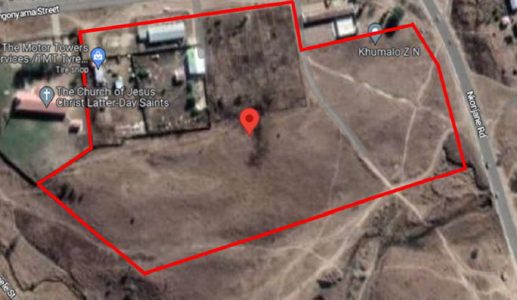
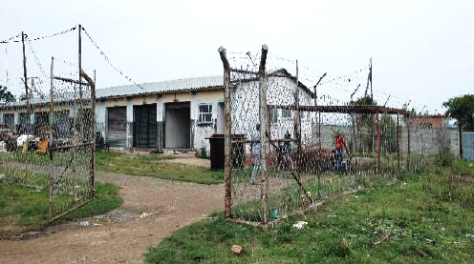
  D2282 EZAKHENI - OVERVIEW
D2282 Ezakheni is invaded commercial land located at Ezakheni D, within Alfred Duma Municipality, KwaZulu Natal.
Extent of land: 4.9313 H
The property has been PARTLY invaded by business operators who are currently occupying 4 different lots which accommodate a variety of business on the erf. Plots which have been created by the invaders have a combined total extent of 14 153 m2, 28% of erf D2282.
OTHER BUSINESSES OPERATING WITHIN THE AREA
a. Motor Towers and Dunlop TMT tyre repair shop.
b. Master hardware
c. Ezakheni Plaza taxi rank.
d. Ezakheni Plaza with the following shops:
  i. P & L hardware.
  ii. Liquor City.
  iii. Shoprite supermarket.
  iv. Jet.

Slide 17
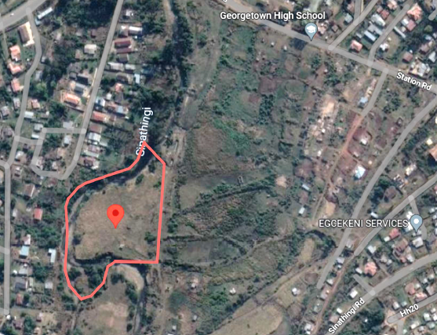
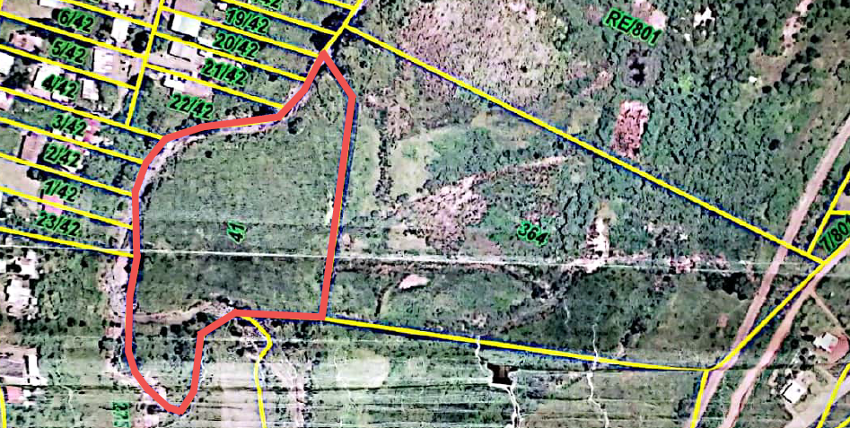
  ERF 41 EDENDALE - OVERVIEW
Erf 41 Edendale is a vacant commercial land located at Edendale, Pietermaritzburg, within Msunduzi Municipality, KwaZulu-Natal.
Property is commercial vacant land, located in a semi-rural area of Edendale, Pietermaritzburg.
Though there have been invasions at other IDFC properties next to erf 41 Edendale, there hasn’t been any invasion on the land as it remains vacant and idle. The land is used for grazing by roaming cows and other livestock owned by local dwellers.
Land is largely covered with vegetation and trees and remains in its original state with no form of improvements made to it.
Property Status | Confirmed details
Extent of land. | 536 m2
Land owner | Ithala Development Finance Corporation
Building owner | No buildings
Lease status | None.
Current Monthly Income | Nil
Municipal rates cost | R167
Access to property | Open access
Boundary | None

Slide 18
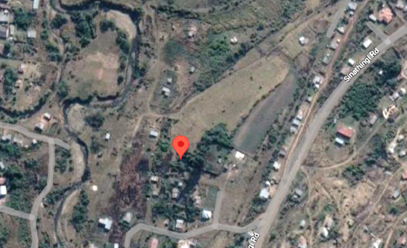
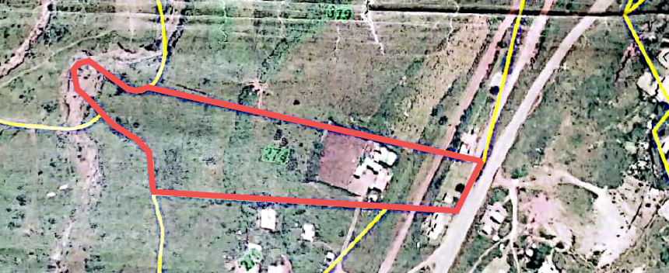
  ERF 274 EDENDALE - OVERVIEW
Erf 274 Edendale is an invaded commercial land located at Edendale, Pietermaritzburg, within Msunduzi Municipality, KwaZulu-Natal.
Property is invaded commercial land, located in a semi-rural area of Edendale, Pietermaritzburg.
Current occupant of land is using the land to accommodate his livestock and the caretakers of the livestock. There are structures on the site built to accommodate the caretakers of the cattle of the occupant.
Land has overgrown vegetation and Bushes.
Property Status | Confirmed details
Extent of land. | 1.7300 H (17 300 m2)
Land owner | Ithala Development Finance Corporation
Building owner | Unknown (To be confirmed)
Lease status | None.
Current Monthly Income | Nil
Municipal rates cost | R260
Access to property | Open access
Boundary | None

Slide 19
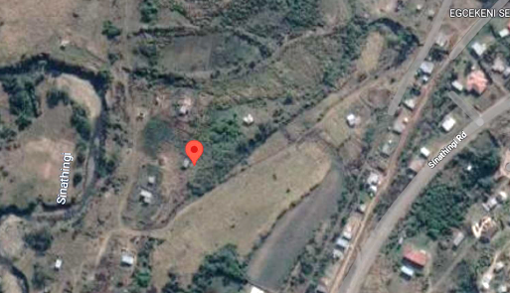
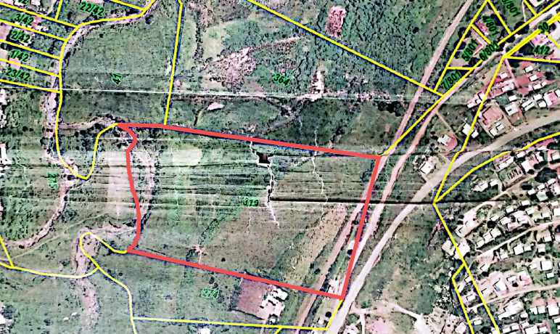
  ERF 319 EDENDALE - OVERVIEW
Erf 319 Edendale is an invaded commercial land located at Edendale, Pietermaritzburg, within Msunduzi Municipality, KwaZulu-Natal.
Property is invaded commercial land, located in a semi-rural area of Edendale, Pietermaritzburg.
Property is invaded and there are currently about 5 different homes which have been erected on the property.
All invasions are using the property for residential properties. Due to the place being semi-rural area, most of the houses are not built to comply with building standards and are regarded as informal houses.
Property Status | Confirmed details
Extent of land. | 4.0651 H (40 651 m2)
Land owner | Ithala Development Finance Corporation
Building owner | No building
Lease status | None – occupant to be confirmed
Current Monthly Income | Nil
Municipal rates cost | R773
Access to property | Open access
Boundary | None

Slide 20
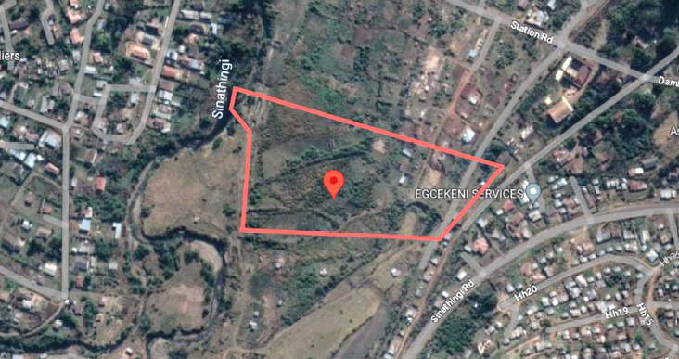
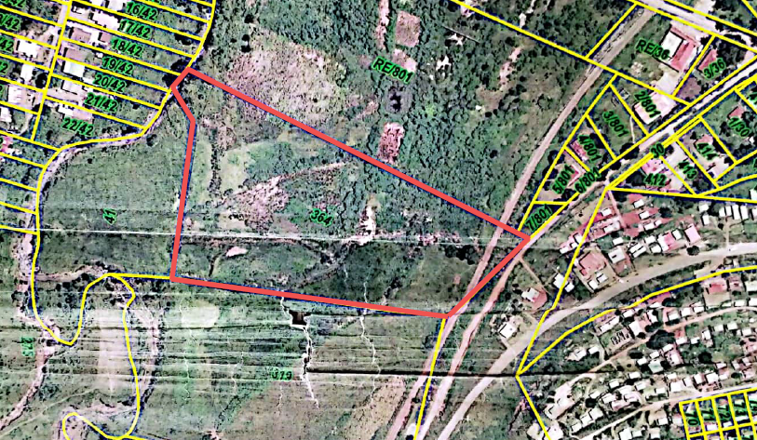
  ERF 364 EDENDALE - OVERVIEW
Erf 364 Edendale is a vacant commercial land located at Edendale, Pietermaritzburg, within Msunduzi Municipality, KwaZulu-Natal.
Property is vacant commercial land, located in a semi-rural area of Edendale, Pietermaritzburg.
Though there have been invasions at other IDFC properties next to erf 364 Edendale, there hasn’t been any invasion on the land as it remains vacant and idle. The land is used for grazing by roaming cows and other livestock owned by local dwellers.
Land is largely covered with vegetation and trees and remains in its original state with no form of improvements made to it.
Property Status | Confirmed details
Extent of land. | 3.917 H (3 917 m2)
Land owner | Ithala Development Finance Corporation
Building owner | No building
Lease status | None – occupant to be confirmed
Municipal rates cost | R725
Access to property | Open access
Boundary | None

Slide 21
  DD7924 EDENDALE - OVERVIEW
DD7924 Edendale is a vacant commercial land located at Edendale within the Msunduzi Municipality,
Pietermaritzburg, KwaZulu-Natal.
Due to lack of maintenance of the land, there is overgrown trees and vegetation, which is promoting illegal waste dumping
Property Status | Confirmed details
Extent of land. | 1061 m²
Land owner | IDFC
Lease status | None – vacant land
Access to property. | Open access
Boundary | No Boundary fence

Slide 22
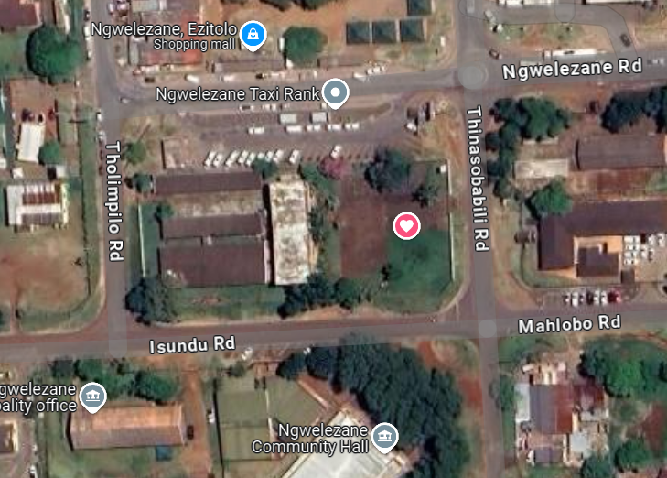
  A1253 NGWELEZANA (OFFICE BLOCK) - OVERVIEW
A1253 Ngwelezana is dilapidated office block located at Ngwelezana A, within City of uMhlathuze Municipality, KwaZulu Natal.
Commercially zoned office block.
Currently 100% vacant.
Potential re-development into student / medical staff accommodation, small retail centre.
Property Status | Confirmed details
Extent of land. | 4 856 m²
Lettable area | 1 444m²
Land owner | Bantu Investment Corporation Limited (IDFC)
Lease status | Currently vacant
Current Monthly Income | Nil
Access to property. | Security on site
Boundary | Concrete security wall and mesh wire.

Slide 23
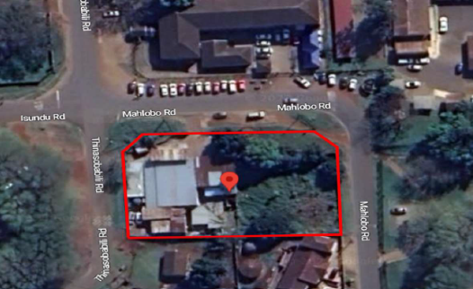
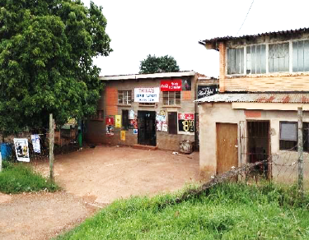
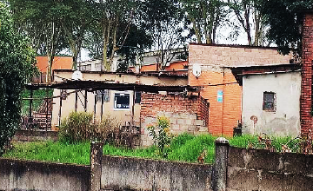
  A1238 NGWELEZANA- OVERVIEW
A1238 Ngwelezana is an invaded commercial property located at Ngwelezana A, within City of uMhlathuze Municipality, KwaZulu Natal.
The property is equally divided into two (2) portions. Property has dilapidated buildings and informal structures which are currently occupied by an unknown individual who is operating a Tavern on one unit of the building while leasing the other unit to a Supermarket operator portion 2 is vacant land without any structural development on it.
There was no access to undertake adequate condition assessment of the property however, based on external overview, the structure is in an unacceptable condition due to dilapidated building facilitates as well multiple informal outbuildings built on the premises.
Multiple outbuildings have been haphazardly placed and erected on the property for unknown purposes.
Property Status | Confirmed details
Extent of land. | 2495m2
Land owner | Bantu Investment Corporation Limited (IDFC)
Lease status | Illegally occupied by invader
Current Monthly Income | Nil
Access to property. | Screen gates
Boundary | Concrete security wall and mesh wire.

Slide 24
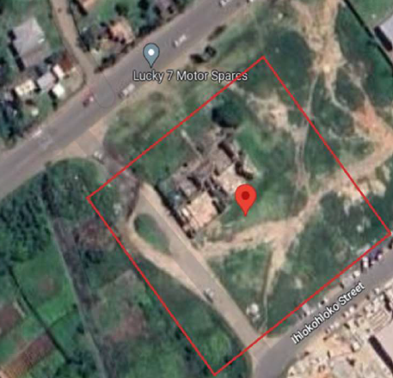
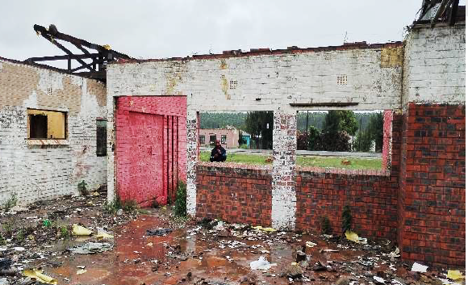
  H1074 ESIKHAWINI BEERHALL - OVERVIEW
H1074 Esikhawini is a dilapidated commercial property located at Esikhawini extension H, within City of
uMhlathuze Municipality, KwaZulu Natal.
Property was previously used as a beerhall for the sale of beer, mainly sorghum beer. It is currently in a dilapidated state due to vandalism and neglect. The structure has since been demolished.
On the same site as the Esikhawini Beerhall there is a EDTEA detergent centre under construction
Property Status | Confirmed details
Extent of land. | 5 950m2
Land owner | IDFC
Current Monthly Income | Nil
Municipal rates cost | R1273 (Monthly)
Access to property. | Open
Boundary | None

Slide 25
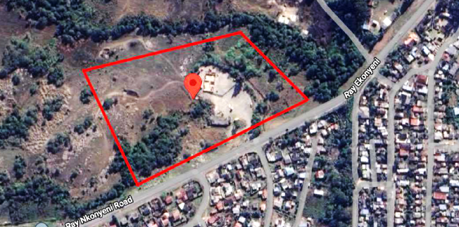
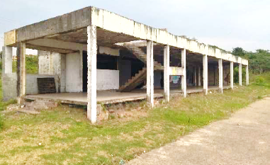
  A2260 GAMALAKHE - OVERVIEW
A2260 Gamalakhe is a dilapidated commercial property located at Gamalakhe township, within Ray Nkonyeni Local Municipality, KwaZulu-Natal.
Erf A2260 has an extent of 39 845 m2, only about 6 500 m2 is occupied by structures and open area with concrete paving. The remaining 33 345 m2 is vacant land which is laying idle.
There are currently two structures on this site namely, the dilapidated beerhall and detergent centre under construction by Department of Economic Development, Tourism and Environmental Affairs – appointed IDFC as the Implementing agent.
Dilapidated beerhall structure

Slide 26
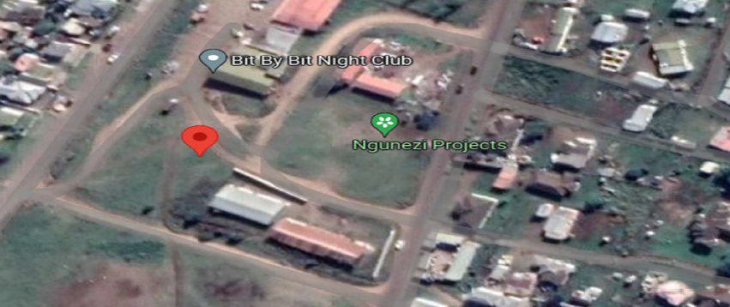
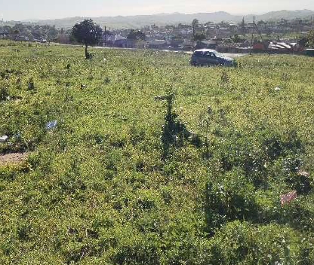
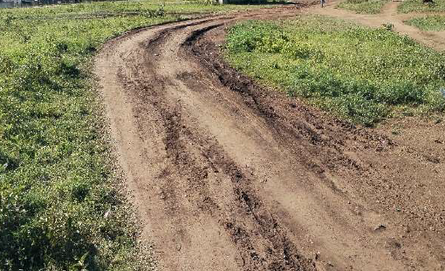
  A1330 KWAMSANE - OVERVIEW
A1330 Kwamsane is vacant commercial land located at Kwamsane, within Mtubatuba Local Municipality, KwaZulu Natal.
The property is located amongst a roll of small sized commercial plots within the Kwamsane business centre.
All the sites are vacant and do not have any signs of structural invasion.
There currently exists an informal access road which passes through erf A1330 and A1289
Other businesses operating in the area: Local Supermarket; Local building hardware and building supplies and Bit by Bit night club.
Property Status | Confirmed details
Extent of land. | 297 m²
Land owner | IDFC
Lease status | None – vacant land
Current Monthly Income | Nil
Access to property. | Open access
Boundary | No Boundary fence

Slide 27



  A1281 KWAMSANE - OVERVIEW
A1281 Kwamsane is invaded commercial land located at Kwamsane, within Mtubatuba Local Municipality, KwaZulu Natal.
The land has been occupied by the Zion Christian Church (ZCC) since 1989 as indicated by Mtubatuba Municipality, in a communication letter issued by the Municipal Manager.
ZCC church leader indicated that the church was indeed allocated to them by the Local Municipality. However, upon enquiring with the Municipality, only the letter confirming the land allocation to ZCC was issued without any supporting documentation for the allocation. Further stated in the letter is that the land is zoned as a place of Worship, possibly due to the land being occupied by the Church for such a long time.
Property Status | Confirmed details
Extent of land. | 3664 m2
Land owner | IDFC
Lease status | None – Invaded by Zion Christian Church (ZCC).
Current Monthly Income | Nil
Access to property. | Mesh Wire Steel Gates
Boundary | Mesh Wire Fencing

Slide 28
  LOT 16 MELMOTH - OVERVIEW
Lot 16 Melmoth is a vacant commercial land located at Melmoth within Mthonjaneni Municipality, Melmoth,
KwaZulu-Natal.
Property is situated within at the outskirts of the Industrial area of Melmoth. It is fully registered to Ithala
Development Finance Corporation limited with a full extent of 2.4218 Hectares. The land is fully vacant
without any form of invasion. It is located on prime land such that multiple commercial projects can be undertaken including the development of an Industrial Estate.
Property Status | Confirmed details
Extent of land. | 2.4 HA
Land owner | IDFC
Lease status | None – vacant land
Access to property. | Open access
Boundary | No Boundary fence

Slide 29



  B170 NCOTSHANE - OVERVIEW
B170 Ncotshane is a dilapidated commercial property located at Ncotshane B, within uPhongolo Municipality,
KwaZulu Natal.
B170 Ncotshane is commercial land with a full extent of about 2.2329 Hectares with which about 2 500 m2 (11 %) is occupied by IDFC Factory units A and B while the remaining 19 739 m 2 (89 %) has been invaded by the development of residential homes of the Ncotshane community.
Factory units A are vacant however they are casually used by loiters as shelter and for other various activities. The structure is in a good – satisfactory condition making it functional and safe for use with maintenance, renovations and repaired.
Factory units B is not as dilapidated as factory unit A because it is occupied by members of the community using unit B2 as a Community Hall while unit B3 is used as a Gymnasium.
Property Status | Confirmed details
Extent of land. | 2500M2
Land owner | IDFC
Lease status | Invaders
Current Monthly Income | Nil
Access to property. | Steel Gates
Boundary | Diamond Fence
Factory Unit A
Factory Unit B

Slide 30
  INDUSTRIAL ESTATES
IDFC owns 3 Large Industrial Estates i.e.
Isithebe Industrial Estate,
Ezakheni Industrial Estate
Madadeni Industrial Estate.
IDFC offers tenants the following services at the estates:
Leasing of Property
Facilities Management (maintenance, security, etc.)
Supply of Services
Water
Electricity
Refuse Removal
Sewerage Disposal
Fire Protection
  IDFC owns a total of 168 plots of vacant industrial land totally 177 hectares that are ready for development within the Isithebe, Ezakheni and Madadeni Industrial Estates.

Slide 31


  VACANT LAND : ISITHEBE INDUSTRIAL ESTATE
The 414 hectare Isithebe Industrial Estate (over 500 000m² of GLA) located in Mandeni and midway between the ports of Durban and Richards Bay, has 151 IDFC owned and 49 privately owned factories, ranging in size from 250m² to 36000m² and is home to a wide range of large and medium sized industrialists.
The Estate also has 56 vacant serviced platforms available for development.
A no. of vacant factories, including a 36 000m² ex foundry is available for re-purposing into potential SMME / light industrial parks.

Slide 32

  ISITHEBE INDUSTRIAL ESTATE

Slide 33

  ISITHEBE INDUSTRIAL ESTATE
141 White street

Slide 34

  ISITHEBE INDUSTRIAL ESTATE
61 on Brown Street

Slide 35

  ISITHEBE INDUSTRIAL ESTATE
134 on Brown

Slide 36

  ISITHEBE INDUSTRIAL ESTATE

Slide 37
  ISITHEBE ESTATE – VACANT LAND
No. | Estate | Site no. | Site Size (m²) | Type | Status
1 | Isithebe Industrial Estate | 58 | 6 710 | Industrial | Vacant
2 | Isithebe Industrial Estate | 67 | 5 678 | Industrial | Vacant
3 | Isithebe Industrial Estate | 72 | 6 482 | Industrial | Vacant
4 | Isithebe Industrial Estate | 85 | 4 791 | Industrial | Vacant
5 | Isithebe Industrial Estate | 112 | 14 948 | Industrial | Vacant
6 | Isithebe Industrial Estate | 134 | 7 829 | Industrial | Vacant
7 | Isithebe Industrial Estate | 141 | 3 938 | Industrial | Vacant
8 | Isithebe Industrial Estate | 149 | 11 279 | Industrial | Vacant
9 | Isithebe Industrial Estate | 159 | 15 023 | Industrial | Vacant
10 | Isithebe Industrial Estate | 160 | 14 897 | Industrial | Vacant
11 | Isithebe Industrial Estate | 163 | 13 115 | Industrial | Vacant
12 | Isithebe Industrial Estate | 186 | 4 165 | Industrial | Vacant
13 | Isithebe Industrial Estate | 188 | 3 328 | Industrial | Vacant
14 | Isithebe Industrial Estate | 189 | 4 991 | Industrial | Vacant
15 | Isithebe Industrial Estate | 192 | 5 096 | Industrial | Vacant
16 | Isithebe Industrial Estate | 196 | 4 818 | Industrial | Vacant
17 | Isithebe Industrial Estate | 197 | 4 003 | Industrial | Vacant
18 | Isithebe Industrial Estate | 198 | 4 217 | Industrial | Vacant
19 | Isithebe Industrial Estate | 203 | 6 620 | Industrial | Vacant
20 | Isithebe Industrial Estate | 207 | 8 590 | Industrial | Vacant
21 | Isithebe Industrial Estate | 211 | 6 973 | Industrial | Vacant
22 | Isithebe Industrial Estate | 214 | 6 907 | Industrial | Vacant
23 | Isithebe Industrial Estate | 215 | 7 956 | Industrial | Vacant
24 | Isithebe Industrial Estate | 216 | 4 429 | Industrial | Vacant
25 | Isithebe Industrial Estate | 217 | 7 641 | Industrial | Vacant
26 | Isithebe Industrial Estate | 221 | 7 028 | Industrial | Vacant
27 | Isithebe Industrial Estate | 233 | 8 737 | Industrial | Vacant

Slide 38
No. | Estate | Site no. | Site Size (m²) | Type | Status
28 | Isithebe Industrial Estate | 239 | 11 726 | Industrial | Vacant
29 | Isithebe Industrial Estate | 240 | 12 201 | Industrial | Vacant
30 | Isithebe Industrial Estate | 261 | 12 460 | Industrial | Vacant
31 | Isithebe Industrial Estate | 263 | 6 199 | Industrial | Vacant
32 | Isithebe Industrial Estate | 265 | 1 914 | Industrial | Vacant
33 | Isithebe Industrial Estate | 267 | 3 676 | Industrial | Vacant
34 | Isithebe Industrial Estate | 268 | 3 088 | Industrial | Vacant
35 | Isithebe Industrial Estate | 269 | 2 679 | Industrial | Vacant
36 | Isithebe Industrial Estate | 270 | 2 769 | Industrial | Vacant
37 | Isithebe Industrial Estate | 271 | 2 378 | Industrial | Vacant
38 | Isithebe Industrial Estate | 272 | 2 197 | Industrial | Vacant
39 | Isithebe Industrial Estate | 273 | 2 591 | Industrial | Vacant
40 | Isithebe Industrial Estate | 278 | 18 267 | Industrial | Vacant
41 | Isithebe Industrial Estate | 281 | 5 476 | Industrial | Vacant
42 | Isithebe Industrial Estate | 290 | 6 673 | Industrial | Vacant
43 | Isithebe Industrial Estate | 303 | 5 224 | Industrial | Vacant
44 | Isithebe Industrial Estate | 318 | 7 435 | Industrial | Vacant
45 | Isithebe Industrial Estate | 319 | 5 736 | Industrial | Vacant
46 | Isithebe Industrial Estate | 350 | 6 234 | Industrial | Vacant
47 | Isithebe Industrial Estate | 360 | 9 313 | Industrial | Vacant
48 | Isithebe Industrial Estate | 375 | 7 612 | Industrial | Vacant
49 | Isithebe Industrial Estate | 376 | 44 895 | Industrial | Vacant
50 | Isithebe Industrial Estate | 379 | 3 448 | Industrial | Vacant
51 | Isithebe Industrial Estate | 380 | 3 803 | Industrial | Vacant
52 | Isithebe Industrial Estate | 381 | 3 791 | Industrial | Vacant
53 | Isithebe Industrial Estate | 382 | 3 586 | Industrial | Vacant
54 | Isithebe Industrial Estate | 383 | 3 852 | Industrial | Vacant
55 | Isithebe Industrial Estate | 384 | 3 675 | Industrial | Vacant
56 | Isithebe Industrial Estate | 385 | 3 862 | Industrial | Vacant

Slide 39
  ISITHEBE ESTATE – DILAPIDATED BUILDINGS
Site No. | Lettable Area (m2)
61 | 1 170
108 | 3 392
276 | 1 240
287 | 3 287
352 | 7 309
362 | 2 984
378 | 3 335
165 (Burnt factory) | 2 271
288 (Burnt factory) | 2 450
Total

Slide 40


  VACANT LAND : EZAKHENI INDUSTRIAL ESTATE
Ezakheni Industrial Estate is situated in Ladysmith, almost equidistant between Durban, Africa’s busiest harbour and Gauteng, the country’s major industrial hub and consumer market. Major industries include fridges, clothing and textiles and bulk bags
The Estate also has 81 vacant serviced platforms available for development.
A no. of vacant factories, are available for occupation/re-purposing

Slide 41

  EZAKHENI INDUSTRIAL ESTATE

Slide 42

  EZAKHENI INDUSTRIAL ESTATE

Slide 43

  EZAKHENI INDUSTRIAL ESTATE

Slide 44

  EZAKHENI INDUSTRIAL ESTATE

Slide 45

  EZAKHENI INDUSTRIAL ESTATE

Slide 46

  EZAKHENI INDUSTRIAL ESTATE

Slide 47

  EZAKHENI INDUSTRIAL ESTATE

Slide 48
  VACANT LAND : EZAKHENI INDUSTRIAL ESTATE
No. | Estate | Site no. | Site Size (m²) | Type | Status
1 | Ezakheni Industrial Estate | 203 | 11 955 | Industrial | Vacant
2 | Ezakheni Industrial Estate | 211 | 2 761 | Industrial | Vacant
3 | Ezakheni Industrial Estate | 213 | 5 175 | Industrial | Vacant
4 | Ezakheni Industrial Estate | 216 | 7 213 | Industrial | Vacant
5 | Ezakheni Industrial Estate | 217 | 4 147 | Industrial | Vacant
6 | Ezakheni Industrial Estate | 219 | 4 123 | Industrial | Vacant
7 | Ezakheni Industrial Estate | 223 | 4 189 | Industrial | Vacant
8 | Ezakheni Industrial Estate | 226 | 13 817 | Industrial | Vacant
9 | Ezakheni Industrial Estate | 227 | 11 124 | Industrial | Vacant
10 | Ezakheni Industrial Estate | 228 | 11 118 | Industrial | Vacant
11 | Ezakheni Industrial Estate | 229 | 6 308 | Industrial | Vacant
12 | Ezakheni Industrial Estate | 230 | 5 102 | Industrial | Vacant
13 | Ezakheni Industrial Estate | 231 | 4 371 | Industrial | Vacant
14 | Ezakheni Industrial Estate | 232 | 4 159 | Industrial | Vacant
15 | Ezakheni Industrial Estate | 234 | 5 094 | Industrial | Vacant
16 | Ezakheni Industrial Estate | 240 | 5 148 | Industrial | Vacant
17 | Ezakheni Industrial Estate | 241 | 5 387 | Industrial | Vacant
18 | Ezakheni Industrial Estate | 242 | 5 521 | Industrial | Vacant
19 | Ezakheni Industrial Estate | 245 | 5 545 | Industrial | Vacant
20 | Ezakheni Industrial Estate | 246 | 5 541 | Industrial | Vacant
21 | Ezakheni Industrial Estate | 247 | 5 537 | Industrial | Vacant
22 | Ezakheni Industrial Estate | 248 | 5 532 | Industrial | Vacant
23 | Ezakheni Industrial Estate | 249 | 5 527 | Industrial | Vacant
24 | Ezakheni Industrial Estate | 250 | 5 524 | Industrial | Vacant
25 | Ezakheni Industrial Estate | 251 | 6 321 | Industrial | Vacant
26 | Ezakheni Industrial Estate | 252 | 5 522 | Industrial | Vacant
27 | Ezakheni Industrial Estate | 256 | 6 132 | Industrial | Vacant

Slide 49
  VACANT LAND : EZAKHENI INDUSTRIAL ESTATE
28 | Ezakheni Industrial Estate | 257 | 6 571 | Industrial | Vacant
29 | Ezakheni Industrial Estate | 258 | 7 445 | Industrial | Vacant
30 | Ezakheni Industrial Estate | 263 | 10 872 | Industrial | Vacant
31 | Ezakheni Industrial Estate | 264 | 12 065 | Industrial | Vacant
32 | Ezakheni Industrial Estate | 265 | 12 053 | Industrial | Vacant
33 | Ezakheni Industrial Estate | 266 | 12 021 | Industrial | Vacant
34 | Ezakheni Industrial Estate | 268 | 11 432 | Industrial | Vacant
35 | Ezakheni Industrial Estate | 269 | 4 520 | Industrial | Vacant
36 | Ezakheni Industrial Estate | 270 | 8 131 | Industrial | Vacant
37 | Ezakheni Industrial Estate | 271 | 3 870 | Industrial | Vacant
38 | Ezakheni Industrial Estate | 272 | 3 817 | Industrial | Vacant
39 | Ezakheni Industrial Estate | 273 | 6 363 | Industrial | Vacant
40 | Ezakheni Industrial Estate | 274 | 6 251 | Industrial | Vacant
41 | Ezakheni Industrial Estate | 275 | 9 582 | Industrial | Vacant
42 | Ezakheni Industrial Estate | 276 | 8 403 | Industrial | Vacant
43 | Ezakheni Industrial Estate | 277 | 11 998 | Industrial | Vacant
44 | Ezakheni Industrial Estate | 278 | 11 383 | Industrial | Vacant
45 | Ezakheni Industrial Estate | 279 | 12 013 | Industrial | Vacant
46 | Ezakheni Industrial Estate | 280 | 12 002 | Industrial | Vacant

Slide 50
  VACANT LAND : EZAKHENI INDUSTRIAL ESTATE
47 | Ezakheni Industrial Estate | 283 | 8 236 | Industrial | Vacant
48 | Ezakheni Industrial Estate | 308 | 33 312 | Industrial | Vacant
49 | Ezakheni Industrial Estate | 442 | 14 656 | Industrial | Vacant
50 | Ezakheni Industrial Estate | 445 | 13 281 | Industrial | Vacant
51 | Ezakheni Industrial Estate | 446 | 13 612 | Industrial | Vacant
52 | Ezakheni Industrial Estate | 447 | 14 099 | Industrial | Vacant
53 | Ezakheni Industrial Estate | 448 | 14 135 | Industrial | Vacant
54 | Ezakheni Industrial Estate | 449 | 13 249 | Industrial | Vacant
55 | Ezakheni Industrial Estate | 450 | 18 090 | Industrial | Vacant
56 | Ezakheni Industrial Estate | 340 | 4 664 | Industrial | Vacant
57 | Ezakheni Industrial Estate | 351 | 9 125 | Industrial | Vacant
58 | Ezakheni Industrial Estate | 364 | 12 312 | Industrial | Vacant
59 | Ezakheni Industrial Estate | 464 | 18 059 | Industrial | Vacant
60 | Ezakheni Industrial Estate | 383 | 7 331 | Industrial | Vacant
61 | Ezakheni Industrial Estate | 385 | 7 381 | Industrial | Vacant
62 | Ezakheni Industrial Estate | 390 | 12 545 | Industrial | Vacant
63 | Ezakheni Industrial Estate | 391 | 7 346 | Industrial | Vacant
64 | Ezakheni Industrial Estate | 393 | 6 843 | Industrial | Vacant
65 | Ezakheni Industrial Estate | 394 | 8 346 | Industrial | Vacant
66 | Ezakheni Industrial Estate | 395 | 10 490 | Industrial | Vacant
67 | Ezakheni Industrial Estate | 396 | 10 464 | Industrial | Vacant
68 | Ezakheni Industrial Estate | 397 | 44 735 | Industrial | Vacant
69 | Ezakheni Industrial Estate | 398 | 6 588 | Industrial | Vacant
70 | Ezakheni Industrial Estate | 400 | 13 024 | Industrial | Vacant
71 | Ezakheni Industrial Estate | 401 | 11 356 | Industrial | Vacant
72 | Ezakheni Industrial Estate | 402 | 8 408 | Industrial | Vacant
73 | Ezakheni Industrial Estate | 403 | 7 554 | Industrial | Vacant
74 | Ezakheni Industrial Estate | 404 | 6 299 | Industrial | Vacant
75 | Ezakheni Industrial Estate | 405 | 10 249 | Industrial | Vacant
76 | Ezakheni Industrial Estate | 406 | 15 961 | Industrial | Vacant
77 | Ezakheni Industrial Estate | 407 | 5 776 | Industrial | Vacant
78 | Ezakheni Industrial Estate | 408 | 11 267 | Industrial | Vacant
79 | Ezakheni Industrial Estate | 412 | 6 690 | Industrial | Vacant
80 | Ezakheni Industrial Estate | 414 | 193 360 | Industrial | Vacant
81 | Ezakheni Industrial Estate | 416 | 94 218 | Industrial | Vacant

Slide 51
  DILAPIDATED BUILDINGS : EZAKHENI INDUSTRIAL ESTATE
Site No. | Lettable Area (m2)
195 | 1 767
196 | 1 843
198 | 1 292
199 | 484
202 | 1 893
206 | 1 850
222 | 1 722
243 | 1 166
244 | 1 167
259 | 2 240
327 | 1 240
330 | 1 256
339 | 1 179
388 | 1 738
Total

Slide 52

  VACANT LAND : MADADENI INDUSTRIAL ESTATE
Madadeni Industrial Estate is the smallest of the three Industrial estates and is situated adjacent to Madadeni Township, 17 kilometres away from Newcastle. The majority of the factories on this estate are involved in clothing and textiles however the Estate also hosts one of the largest fibre manufacturing factories in the country
The Estate has 31 vacant serviced platforms available for development. (over 300 000m²)

Slide 53

  MADADENI INDUSTRIAL ESTATE

Slide 54

  MADADENI INDUSTRIAL ESTATE

Slide 55

  MADADENI INDUSTRIAL ESTATE

Slide 56

  MADADENI INDUSTRIAL ESTATE

Slide 57
  VACANT LAND : MADADENI INDUSTRIAL ESTATE
No. | Area | Site no | Site Size (m²) | Type | Status
1 | Madadeni Industrial Estate | 46 | 8 402 | Industrial | Vacant
2 | Madadeni Industrial Estate | 47 | 4 683 | Industrial | Vacant
3 | Madadeni Industrial Estate | 51 | 11 312 | Industrial | Vacant
4 | Madadeni Industrial Estate | 54 | 11 418 | Industrial | Vacant
5 | Madadeni Industrial Estate | 55 | 5 934 | Industrial | Vacant
6 | Madadeni Industrial Estate | 56 | 4 947 | Industrial | Vacant
7 | Madadeni Industrial Estate | 57 | 8 510 | Industrial | Vacant
8 | Madadeni Industrial Estate | 58 | 7 516 | Industrial | Vacant
9 | Madadeni Industrial Estate | 59 | 7 500 | Industrial | Vacant

Slide 58
  VACANT LAND : MADADENI INDUSTRIAL ESTATE
No. | Area | Site no | Site Size (m²) | Type | Status
10 | Madadeni Industrial Estate | 61 | 7 492 | Industrial | Vacant
11 | Madadeni Industrial Estate | 62 | 8 661 | Industrial | Vacant
12 | Madadeni Industrial Estate | 63 | 13 686 | Industrial | Vacant
13 | Madadeni Industrial Estate | 64 | 12 907 | Industrial | Vacant
14 | Madadeni Industrial Estate | 65 | 13 858 | Industrial | Vacant
15 | Madadeni Industrial Estate | 66 | 10 302 | Industrial | Vacant
16 | Madadeni Industrial Estate | 67 | 10 603 | Industrial | Vacant
17 | Madadeni Industrial Estate | 75 | 26 452 | Industrial | Vacant
18 | Madadeni Industrial Estate | 77 | 10 431 | Industrial | Vacant
19 | Madadeni Industrial Estate | 78 | 8 092 | Industrial | Vacant
20 | Madadeni Industrial Estate | 79 | 7 802 | Industrial | Vacant
21 | Madadeni Industrial Estate | 80 | 8 219 | Industrial | Vacant
22 | Madadeni Industrial Estate | 81 | 9 341 | Industrial | Vacant
23 | Madadeni Industrial Estate | 82 | 13 931 | Industrial | Vacant
24 | Madadeni Industrial Estate | 84 | 14 208 | Industrial | Vacant
25 | Madadeni Industrial Estate | 85 | 15 067 | Industrial | Vacant
26 | Madadeni Industrial Estate | 86 | 13 279 | Industrial | Vacant
27 | Madadeni Industrial Estate | 87 | 18 025 | Industrial | Vacant
28 | Madadeni Industrial Estate | 88 | 17 895 | Industrial | Vacant
29 | Madadeni Industrial Estate | 89 | 13 882 | Industrial | Vacant
30 | Madadeni Industrial Estate | 90 | 471 | Industrial | Vacant
31 | Madadeni Industrial Estate | 95 | 6 491 | Industrial | Vacant

Slide 59
  WAY FORWARD
The overall objective is to secure developers to enter into long term lease agreements with IDFC for identified sites, to develop top structures for commercial / industrial purposes.
  Standard IDFC requirements for signing of leases must be met in line with IDFC's lease application process.
Prospective developers will be expected to submit detailed proposals outlining the nature of the proposed development, development costs, source of funding and market and financial feasibilities.
Proposals received will be evaluated based on:
  Ability to fund / raise capital for the development
  Market and financial feasibility
  BBBEE and commitment to economic development and job creation
Interested parties should contact Simanga Mkhize (smkhize@ithala.co.za) for further information.

Slide 60
THANK YOU

